Slide 1
Expendable-Mold Casting Processes

Slide 2
Three Molding Categories
Expendable Molds
Single-use with multiple-use patterns
Single-use with single-use patterns
Reusable Molds
Multiple-use molds

Slide 3
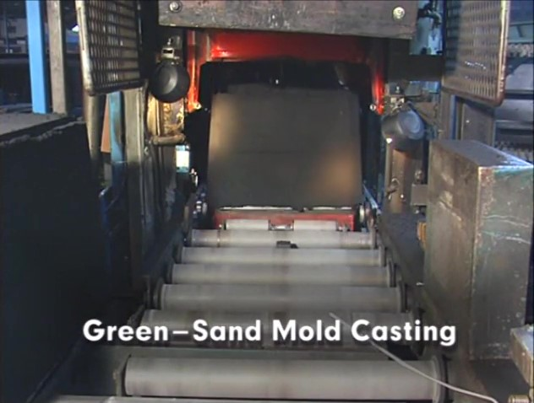
Watch Video Here

Slide 4
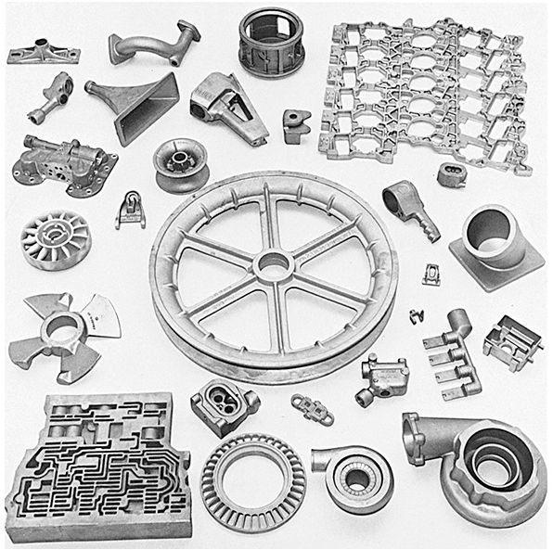
Sand-Cast Parts

Slide 5
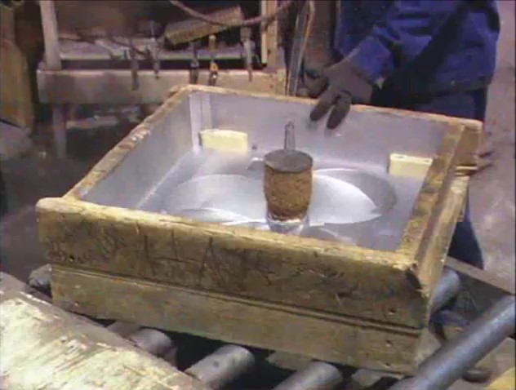
Watch Video Here

Slide 6
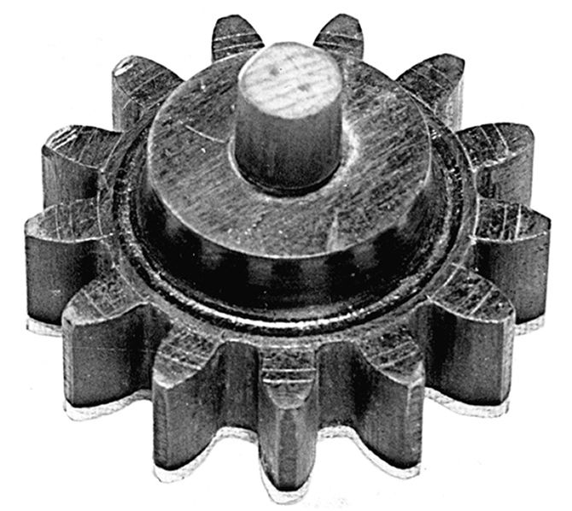
Single-piece pattern

Slide 7
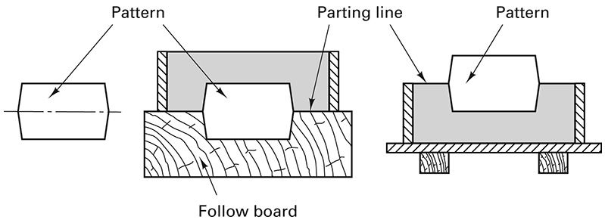
Follow Board for Single-piece Pattern

Slide 8
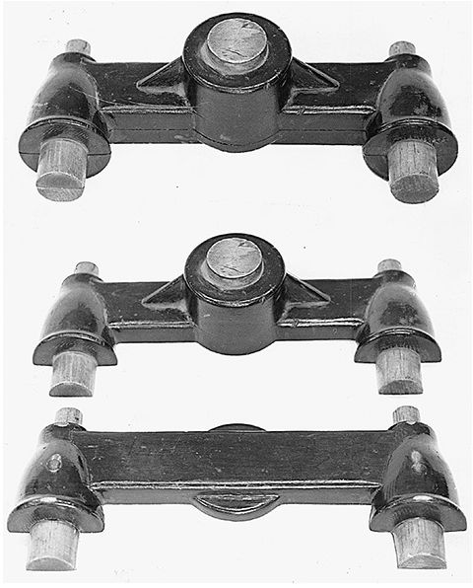
Split Pattern

Slide 9
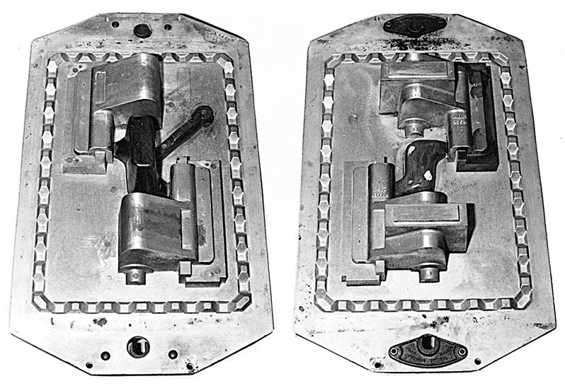
Match-plate Pattern

Slide 10
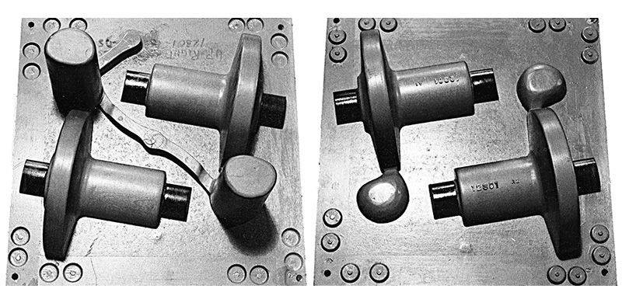
Cope and Drag Patterns

Slide 11
Sand Requirements
Refractoriness – withstand high temps.
Cohesiveness – retain given shape
Permeability – allow gasses to escape
Collapsibility – allow metal to shrink and free casting by disintegration

Slide 12
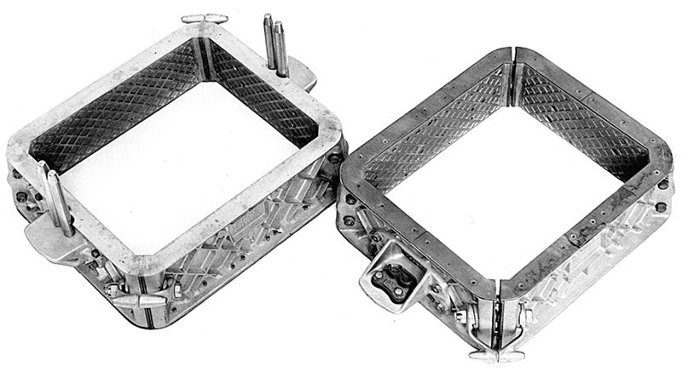
Flasks

Slide 13
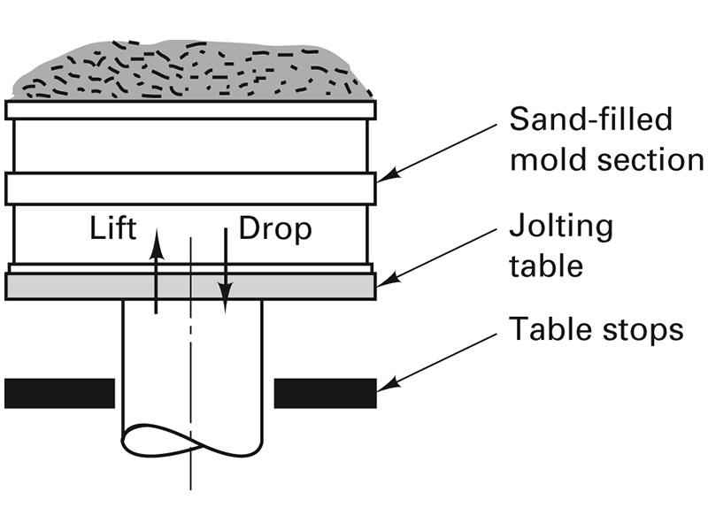
Mold-Making by Jolting

Slide 14
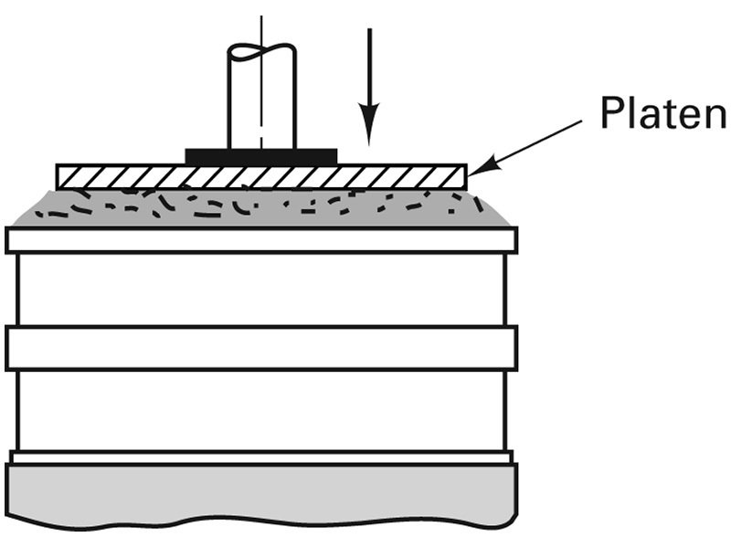
Mold-Making by Squeezing

Slide 15
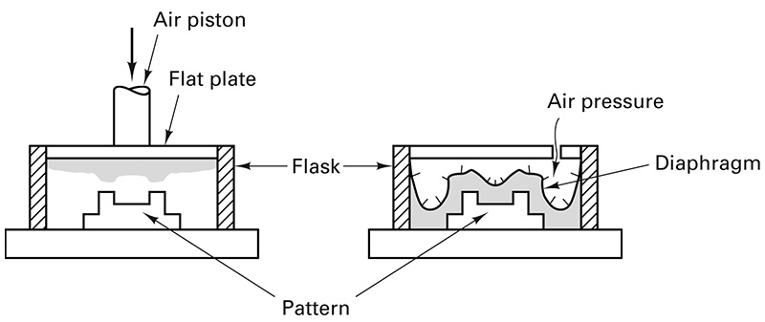
Squeezing and Flexible Diaphragm

Slide 16
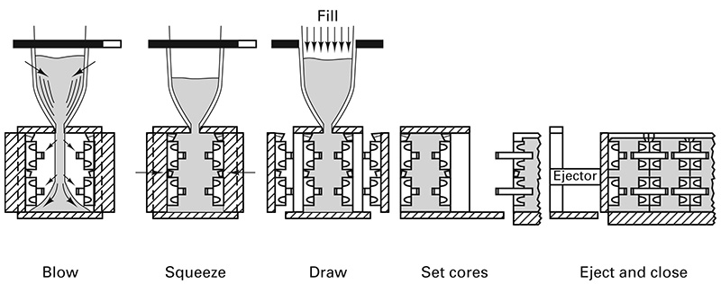
Flaskless Molding Process

Slide 17
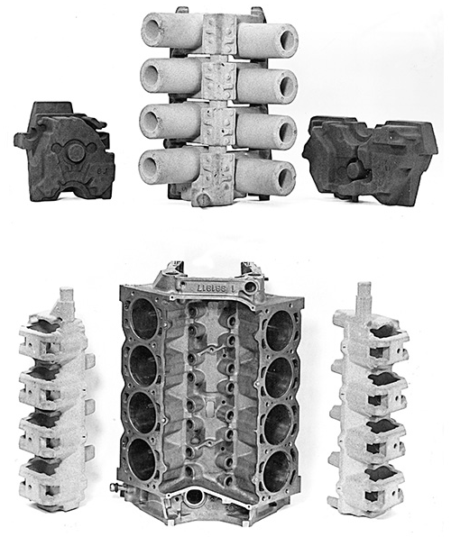
Engine Block Cores

Slide 18
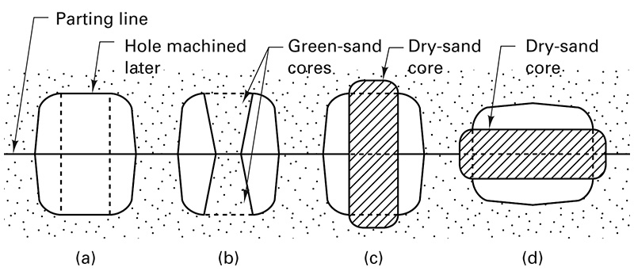
Core Prints

Slide 19
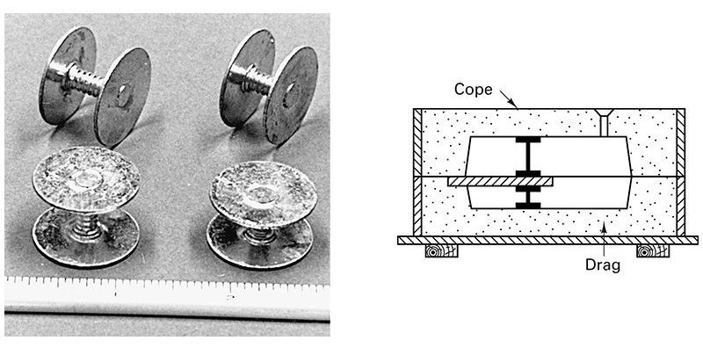
Chaplets to Support Cores

Slide 20
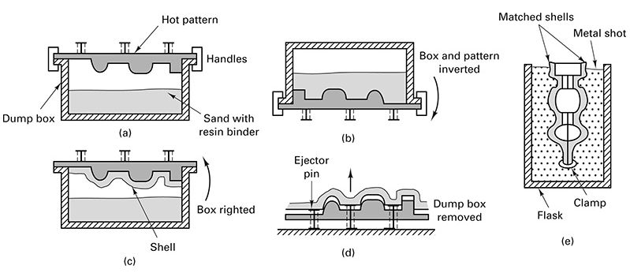
Shell Molding

Slide 21
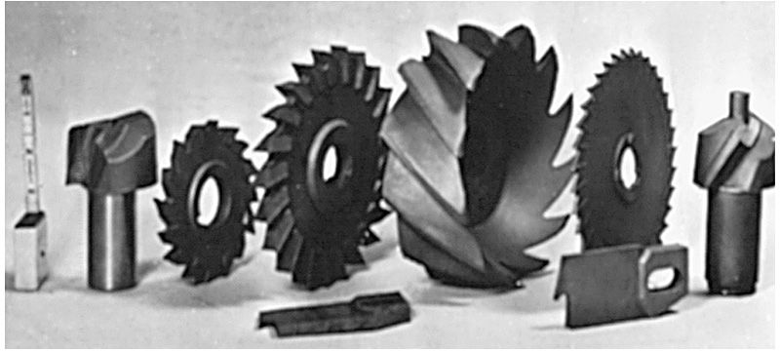
Intricate cutters produce by ceramic casting

Slide 22
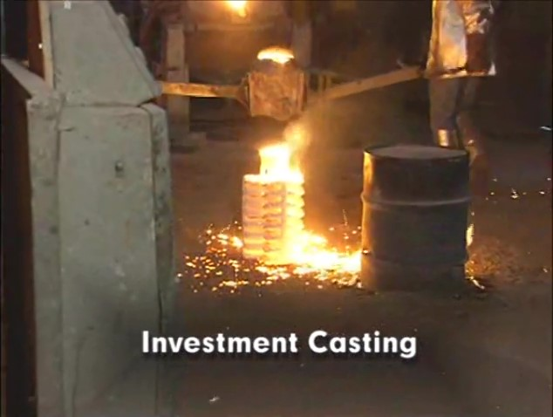
Watch Video Here
Notes:
Investment Casting

Slide 23
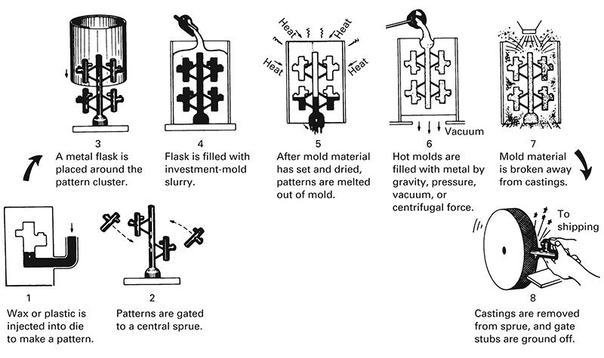
Investment Casting by Flask-Casting

Slide 24
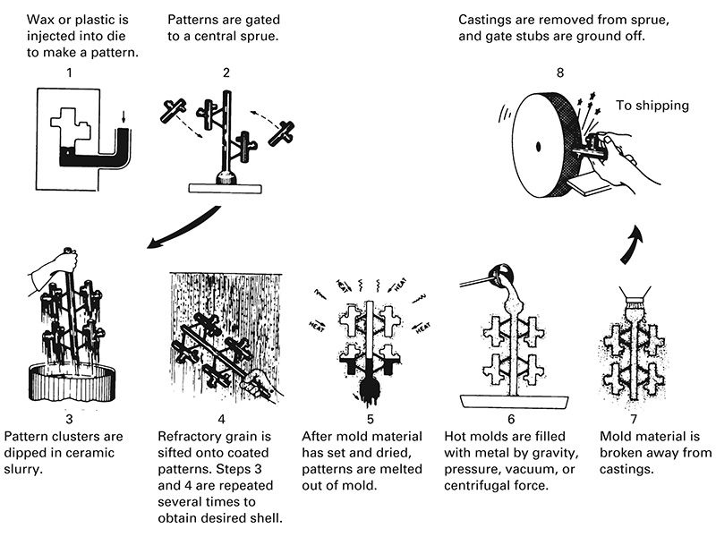
Investment Casting by Shell-Casting

Slide 25
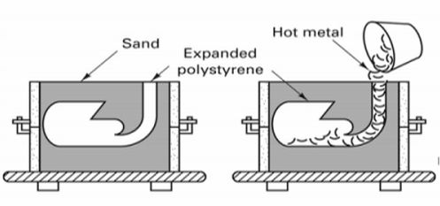
Full-Mold (Lost Foam) Casting

Slide 26
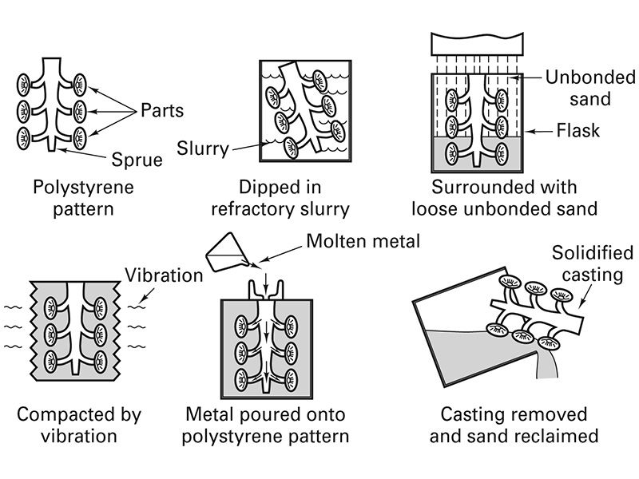
Full Mold (Lost-Foam) Casting Process

Slide 27
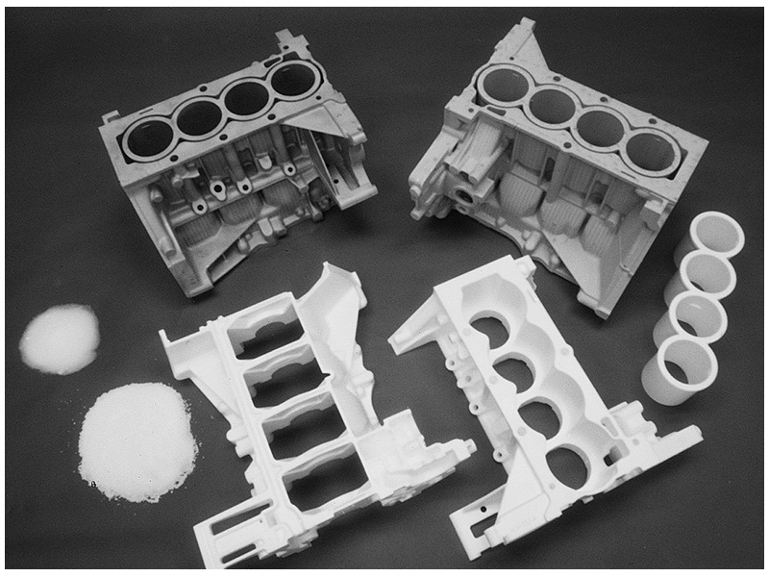
Full Mold (Lost-Foam) Engine Block

